Slide 1

Cybersecurity club

Slide 2

AGENDA
Cybersecurity news
GitHub how to use and manage licensing
Social media
Question?

Slide 3

Cybersecurity news
Sign up for NCL
Hackers Use CAPTCHA Trick on Webflow CDN PDFs to Bypass Security Scanners
PDF files with embedded images that micimc a CAPTCHA challenge cause users who click go to a phishing page
North Korean targeted cyberattacks on south korea
Hacking group Kimsuky, send decoy document as a phishing emails to trigger the infection process using PowerShell scripts for payload delivery, reconnaissance and execution

Slide 4

setting up Github
Create a GitHub account
Install Git on your computer
Download from git-scm.com
Use the terminal for configuration
Verify the configuration with "git config –list"

Slide 5
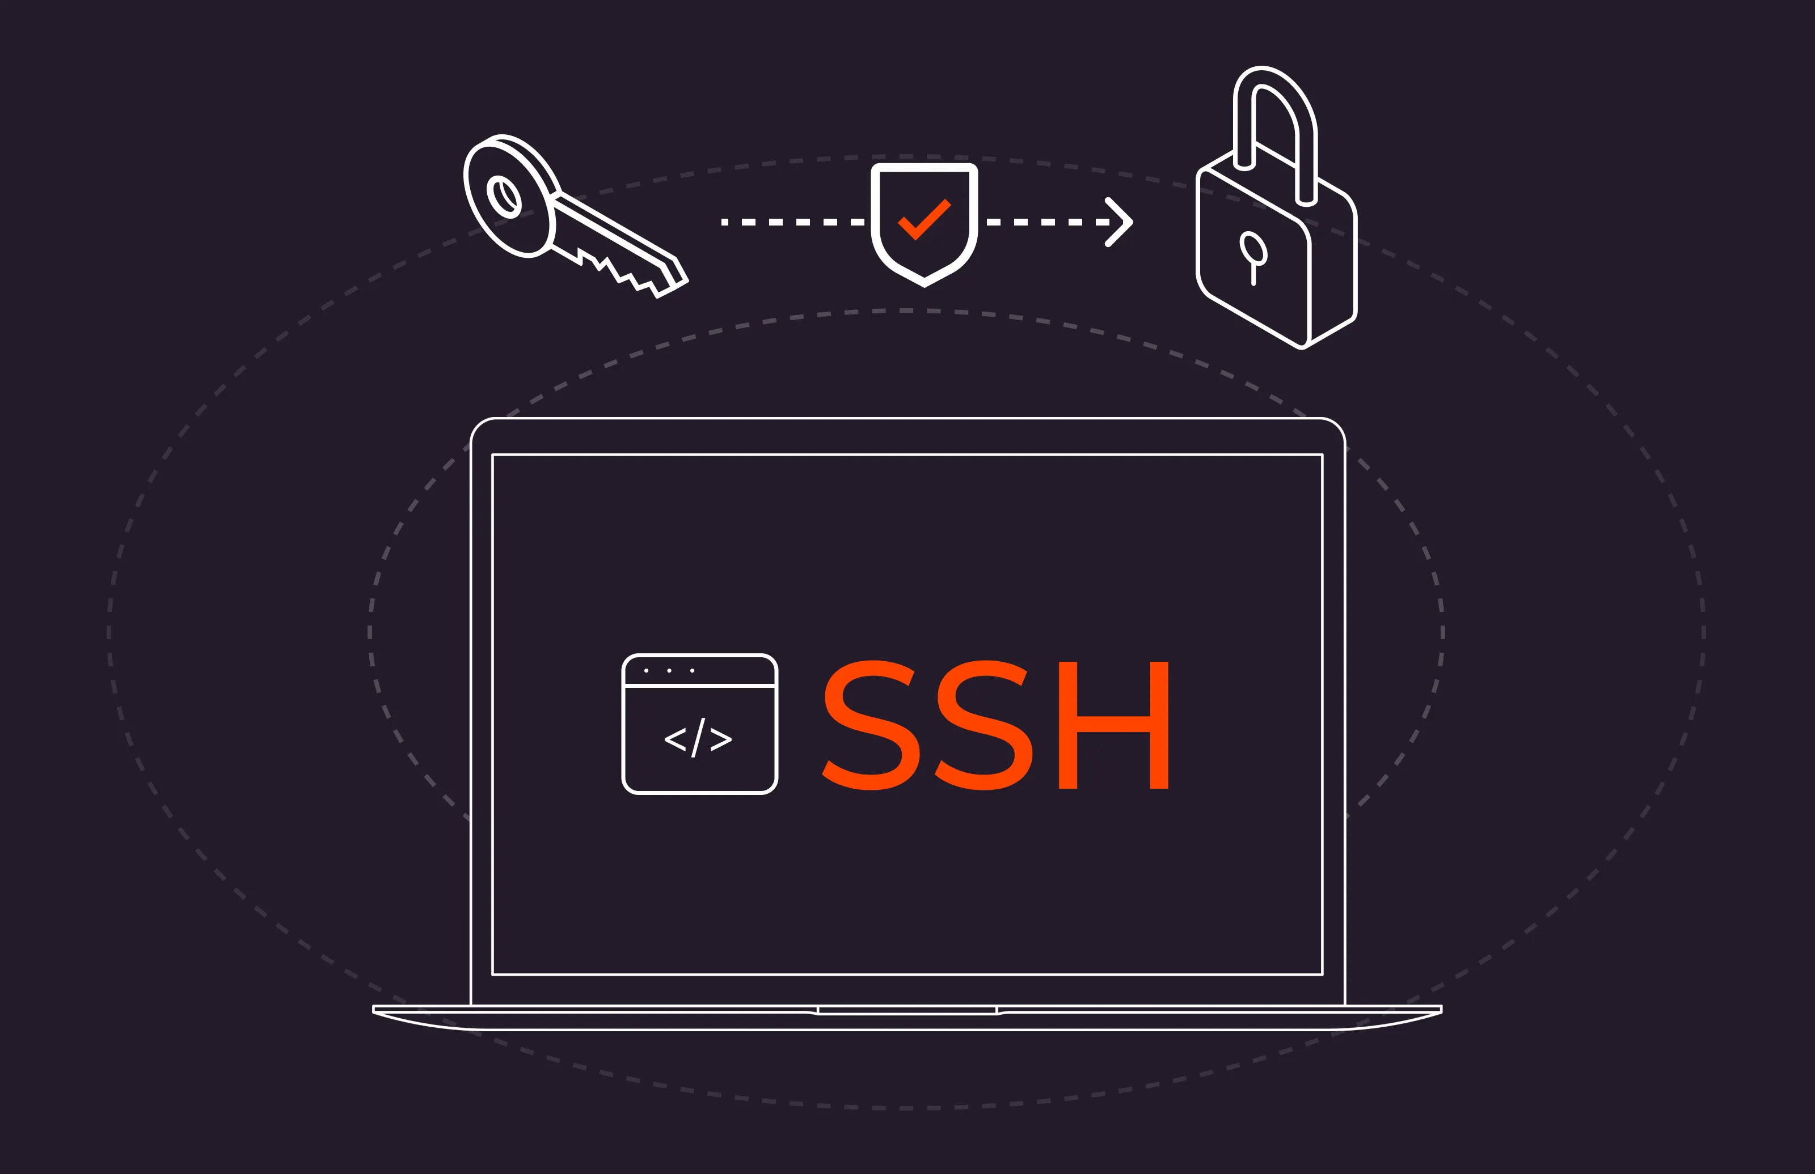
Set up SSH Authentication (optional)
Check for an existing SSH key
ls ~/.ssh/id_rsa.pub
If there isn't a key, make one
ssh-keygen –t rsa –b 4096 –C "your-email@example.com"
Copy the SSH key
cat ~/.ssh/id_rsa.pub
Go to GitHub → Settings → SSH and GPG Keys → New SSH Key → paste your key → Save.
Test connection
ssh –T git@github.com

Slide 6
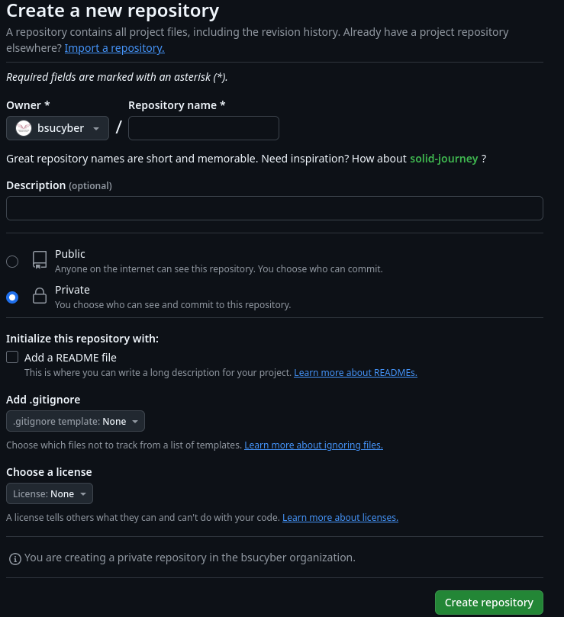
Creating a New Repository
On GitHub, click New Repository
Enter a repository name and description
Choose public or private visibility
Initialize with a README if needed
Click Create Repository

Slide 7
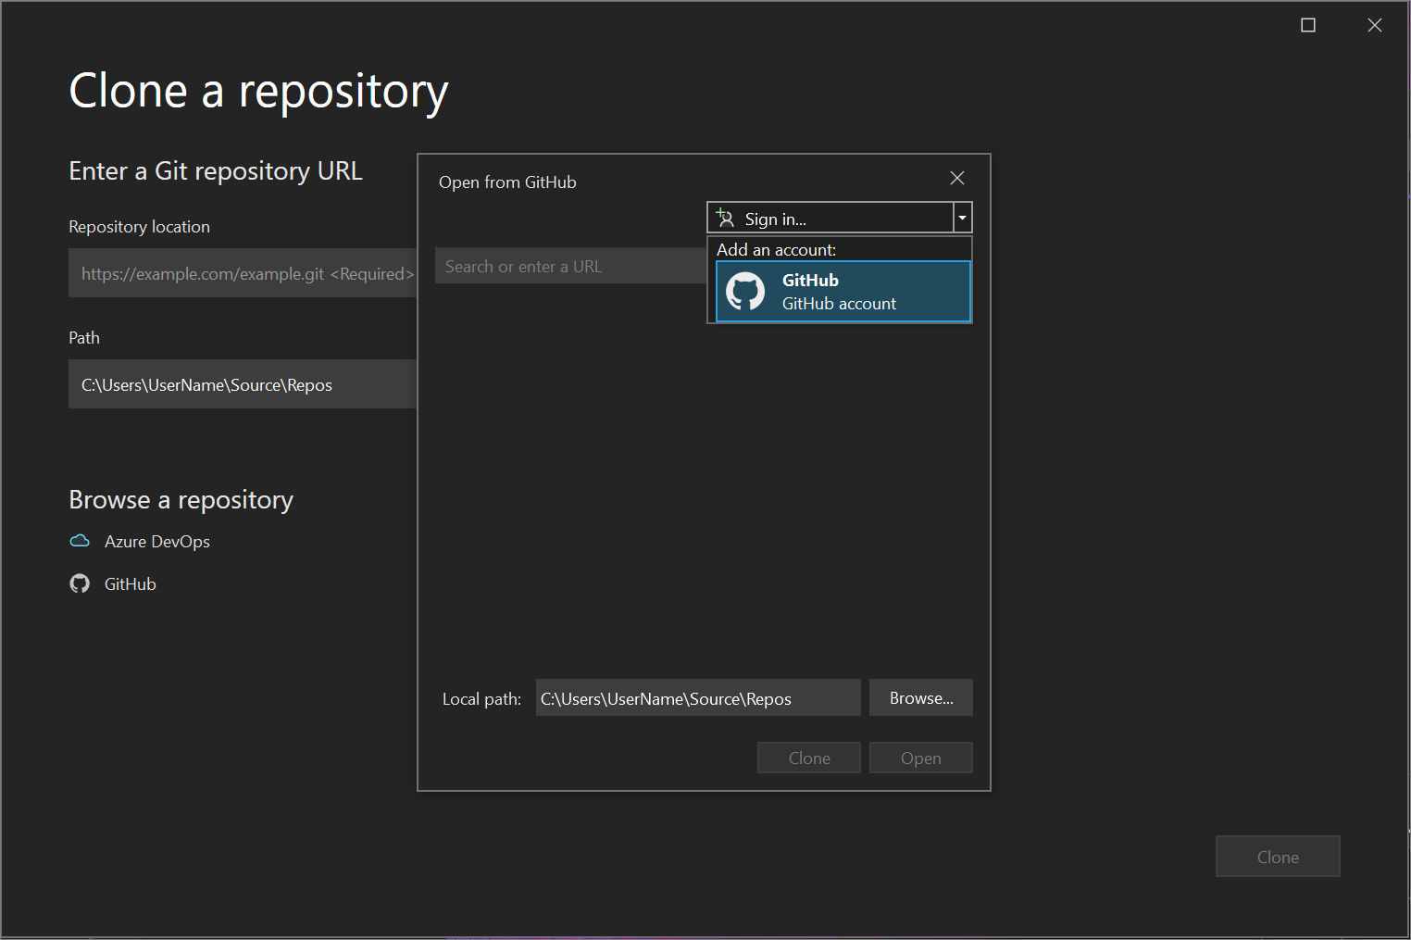
Working with git locally
Clone an Existing Repository
Copy the repository URL from GitHub
Run the following command in a terminal
git clone https://github.com/username/repository.git
Navigate into the cloned directory
cd repository
Create a New Local Repository
Navigate to the desired directory
cd /path/to/your/project
Initialize Git
git init
Add a remote repository (if needed)
git remote add origin https://github.com/username/repository.git

Slide 8
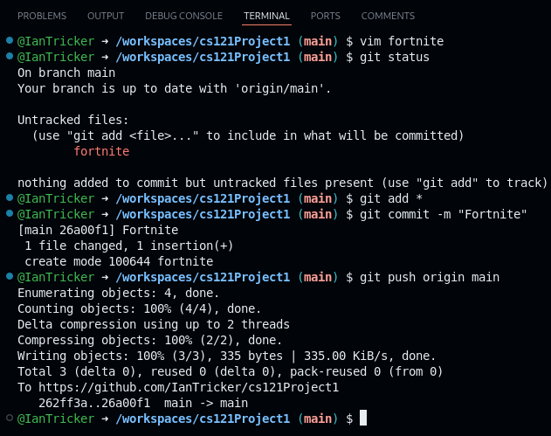
Making and committing changes
Add files or modify existing ones
Check the current status of your changes
git status
Add files too staging
git add
Commit the changes
git commit –m "Your commit message"
Push the changes to GitHub
git push origin main

Slide 9
Branching and merging
Create a New Branch
List existing branches
git Branch
Create a new branch
git branch feature-branch
Switch to the new branch
git checkout feature-branch
Make changes, add, commit, and push
git add
git commit -m "feature update"
git push origin feature-branch
Merge changes
Switch to the main branch
git checkout main
Pull the latest changes
git pull origin main
Merge the feature branch
git merge feature-branch
Push updates to GitHub
git push origin main

Slide 10
Managing licensing
Choose a License
Open choose a License website to fine the right one for the project
Common license include
MIT License (permissive, minimal restrictions)
GPL License (requires derivative works to be open-source)
Apache License (grants patent rights and liability protection)
Creative Commons (ideal for non-software projects)
Add a License to Your Repository
In the repository root, create a LICENSE file
touch LICENSE
Open the file and paste the chosen license text
Commit and push the license file
git add LICENSE
git commit -m "Added LICENSE file"
git push origin main

Slide 11

Best practices
Write clear commit messages
Use .gitignore to exclude unnecessary files
Create pull requests for collaborative work
Regularly pull changes to avoid conflicts
Use GitHub Issues for tracking bugs and features.

Slide 12


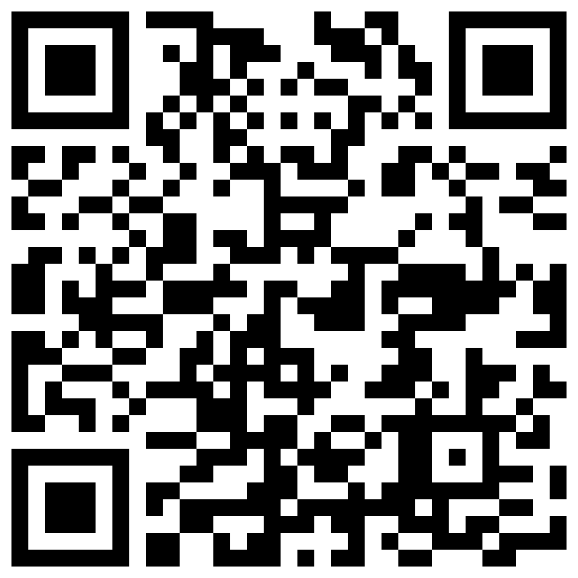
Social Media
Instagram
Discord
https://dsc.gg/bsucyber
BennyLink (Attendance)

Slide 13

Questions

